Slide 1
Module 1 DBMS Extensions and Example Data Warehouses
Lesson 5: Colorado Education Data Warehouse
Notes:
Welcome to Lesson 5 of Module 1 on Relational Database Support for Data Warehouses
Opening question
What does “federated” mean for a data warehouse?
United in an alliance while members retain some level of autonomy

Slide 2
Lesson Objectives
Understand the scope of moderate size data warehouses
Grasp development difficulties
Reflect about mandatory participation by data providers and wide usage by stakeholders
Notes:
Previous lectures
Data modeling principles and schema patterns
Development methodologies for systematic development
Objectives:
Gain insights about the scope of moderate size data warehouses
Grasp difficulties about cooperation and data integration in moderate size data warehouses
Study examples of data warehouses to clarify concepts
Gain insights about intangible benefits for participation by data providers

Slide 3
Development Timeline
Accountability laws
1997 (initial law)
2004 (student growth)
Data warehouse projects
2002 (basic accountability)
2007 (student growth extension and web portals)
2007 (more student growth)
2013 (scope and data integration extensions)
Notes:
Developed to support accountability standards
Federated approach with independent data providers
Supports tracking of growth in student achievement
Public and private portals

Slide 4
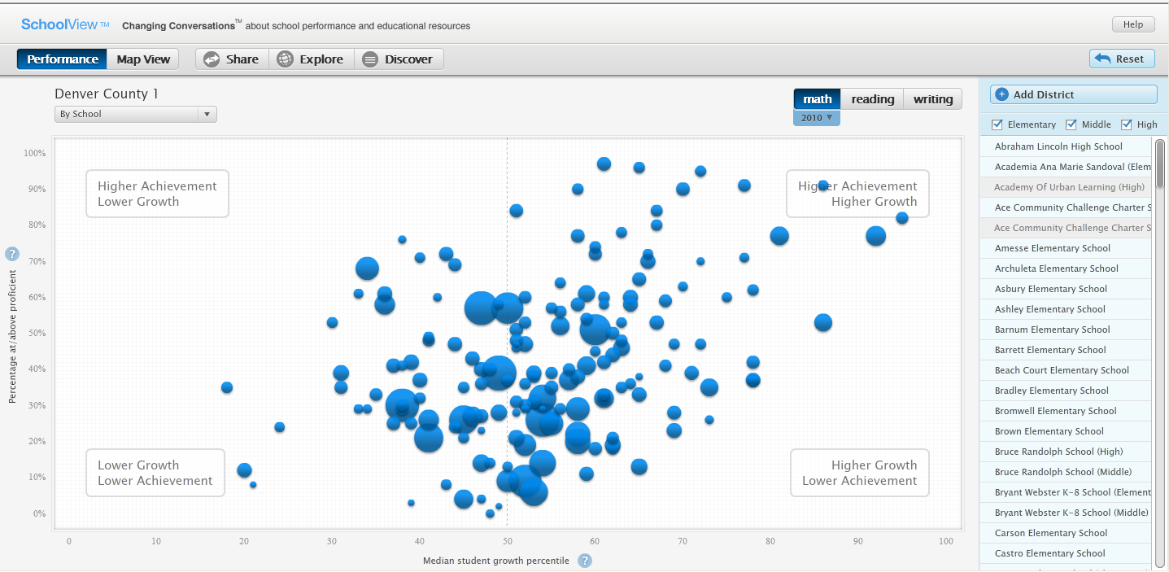
SchoolView Public Portal
Notes:
Colorado SchoolViewTM (http://www.cde.state.co.us/schoolview) is a public portal that uses the Education Data Warehouse. SchoolView supports visual analysis of student growth on the Colorado Student Assessment Program (CSAP) tests for all Colorado school districts. Users can compare median student growth in reading, writing, and math by school as depicted in this slide. In addition, users can search on the dimensions of student group, grade, and ethnicity as well as rolling up to school districts.

Slide 5
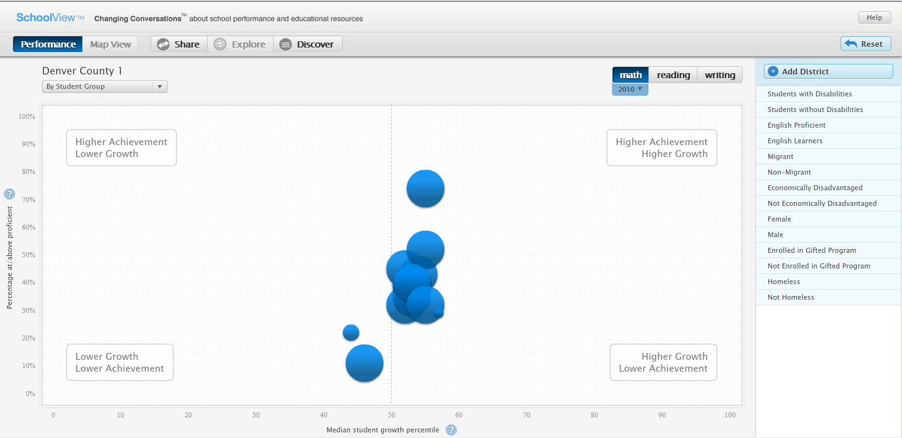
SchoolView Drill-Down Display
Notes:
This slide displays visual results for the student group dimension. By selecting a bubble in the display, users can drill down to the individual member value. SchoolView provides a map interface in addition to standard searching tools for selecting schools and school districts.

Slide 6
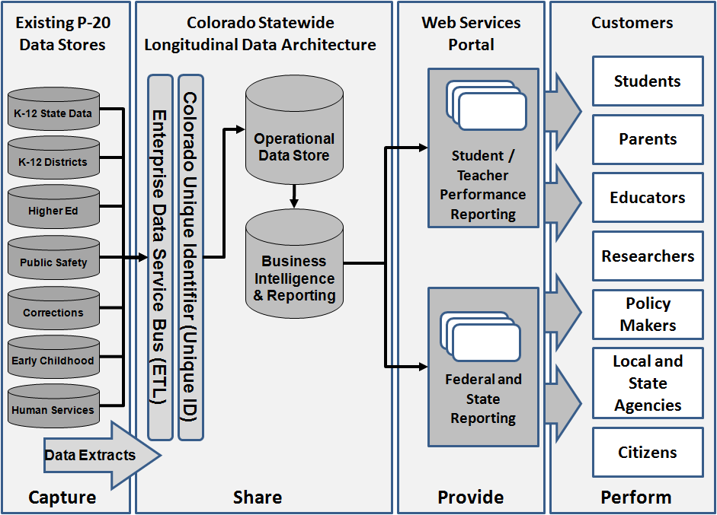
Federated Architecture
Notes:
The primary data source for the data warehouse is the CSAP scores. Students take CSAP tests once per year in the second half of the school year. CSAP scores are maintained by the Colorado Department of Education independent of usage in SchoolView. School districts provide data for student grades and demographic attributes. Colorado has 178 school districts so the number of data sources provided by school districts is large. This slide shows other data sources provided by higher education, public safety, corrections, early childhood development, and human services.

Slide 7
Education Data Warehouse Design
Complex collection of 9 constellation schemas
32 fact tables
94 dimension tables
Modest size
270 GB
200 million rows
1.6 million rows per year in major fact table
Notes:
The data model for the Education Data Warehouse is a complex collection of nine constellation schemas. The constellation schemas contain 94 dimension tables and 32 fact tables. The fact tables have some level of denormalization as the fact tables contain both key and code values instead of just the key values. The constellation schemas have some level of snowflaking as ten dimension tables are referenced in other dimension tables. The schema diagram uses nine pages in Microsoft Visio with each page containing a constellation schema with many connections among fact and dimension tables.
The Education Data Warehouse is modest size compared to enterprise data warehouses of major corporations. The total size of the Education Data Warehouse is about 270 GB. The fact tables have about 200 million rows with 1.6 million rows added per year to the major CSAP fact table.

Slide 8
Standardized Test Schema
Standardized Test Fact (scores, points, percentages, levels)
School
Subject
Conditions (language, disability, …)
District
Time
Grade
Demographics (gender, rural, ethnicity, …)
Notes:
CSAP schema
CSAP fact table: additive (number of points) and semi additive measures (percentage points, scaled score, and growth percentile)
27 dimension tables: flat and hierarchical dimensions

Slide 9
Dimension Tables
DIM_504_PLAN | DIM_ESL | DIM_IEP
DIM_ACCOMMODATION | DIM_ETHNICITY | DIM_LANGUAGE_BACKGROUND
DIM_BILINGUAL | DIM_FARM | DIM_MIGRANT_STATUS
DIM_CBLA_STATUS_CODE | DIM_GENDER | DIM_SCHOOL_EMH
DIM_CSAP_CONTENT_PROFICIENCY | DIM_GIFTED_TALENTED | DIM_SCHOOL_YEAR
DIM_CSAP_SUBJECT | DIM_GRAD_CLASS | DIM_SCHOOL
DIM_DID_NOT_TEST | DIM_GRADE_CALC_EXEMPTION | DIM_TIME_IN_DISTRICT
DIM_DISABLING_CONDITION | DIM_GRADE | DIM_TIME_IN_SCHOOL
DIM_DISTRICT | DIM_HOMELESS | DIM_TITLE_1
Notes:
This table lists dimension tables in the standardized test schema. Most dimension tables contain flat dimensions, typically a code value. For example, dimension tables for ethnicity, homeless, migrant status, and gifted contain a single, flat dimension. Some dimension tables contain hierarchical dimensions and multiple dimensions. For example, the school dimension has location columns that form hierarchical dimensions and other columns comprising flat dimensions. Each dimension table uses two date columns (beginning and ending effective dates) to provide historical integrity.

Slide 10
Measures in Fact Tables
Standardized test results
Additive measures
Show as central tendencies
Summary fact tables with event counts
Finance fact table
Semi-additive measures
Bonded debt level
Notes:
The fact tables contain measures with a variety of aggregation properties. The major fact table for standardized test results contains additive measures (number of points, percentage points, scaled score, and growth percentile) although these measures should be shown as central tendencies (average or median) for reasonable interpretation. Summary fact tables contain event counts such as the number of partially proficient students in a test result. The finance fact tables contain semi-additive measures that can be summarized across time such as bonded debt levels.

Slide 11
Summary
Modest size data warehouse
10+ year development history under legislative mandates
Coordination among many areas of state and local government
New policies for data quality
Brief review of SchoolView and data warehouse design
Notes:
Participation typically compulsory in commercial organizations after development decision is made.
Benefits
Difficult to provide for data providers
External mechanism to support participation

